Slide 1
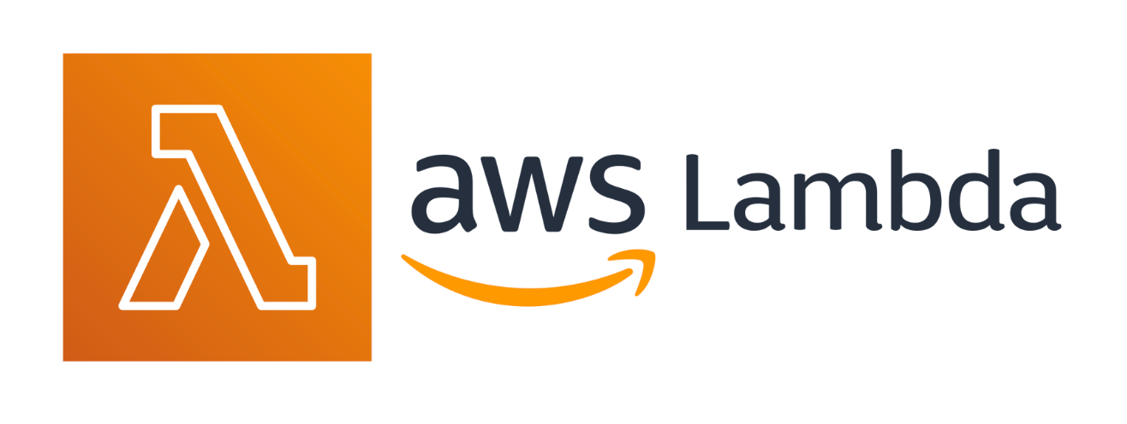

Slide 2
What is Amazon Lambda?
AWS Lambda is a serverless computing service that runs code without managing servers.
Lambda scales automatically, handles server management, security, patching, and monitoring.
Ideal for developers to focus on code without worrying about infrastructure.
Why is it Called "Serverless"?
Serverless doesn’t mean no servers; it means no server management.
AWS handles provisioning, scaling, and patching, so you can focus on your app.

Slide 3
Why Serverless?
Cost-Effective: Pay only for the time your code runs.
Auto-scaling: Scales based on traffic without manual intervention.
Faster Development: Deploy code quickly without infrastructure worries.
Reduced Overhead: AWS handles scaling, patching, and security.
What are Lambda Functions?
Lambda functions are serverless compute functions fully managed by AWS.
Upload your code (in .ZIP or container), and AWS Lambda runs and scales it as needed.
Typically used for event-driven applications (e.g., S3 data processing or API requests).

Slide 4
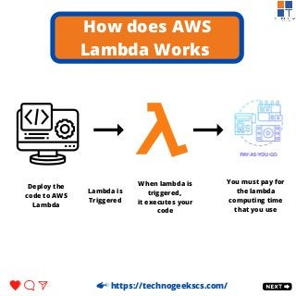
How Does Lambda Work?
Write your code (e.g., Python, Node.js).
Upload it to Lambda (ZIP or container).
Configure a trigger (e.g., file upload, API request).
Lambda runs your code automatically.
You pay only for execution time.

Slide 5
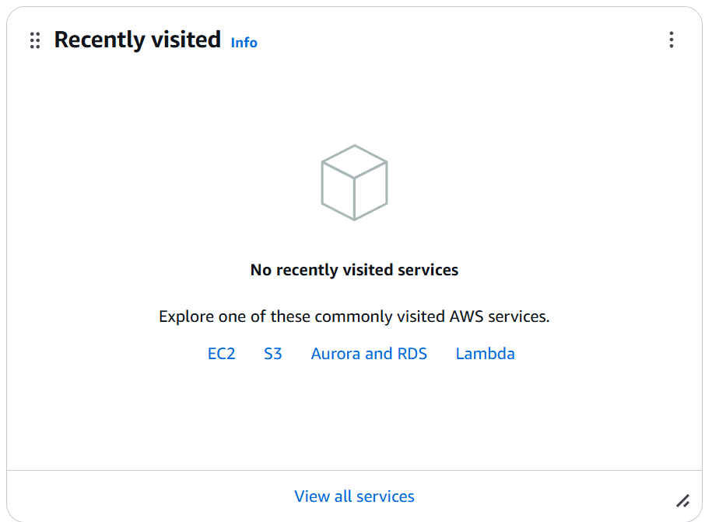
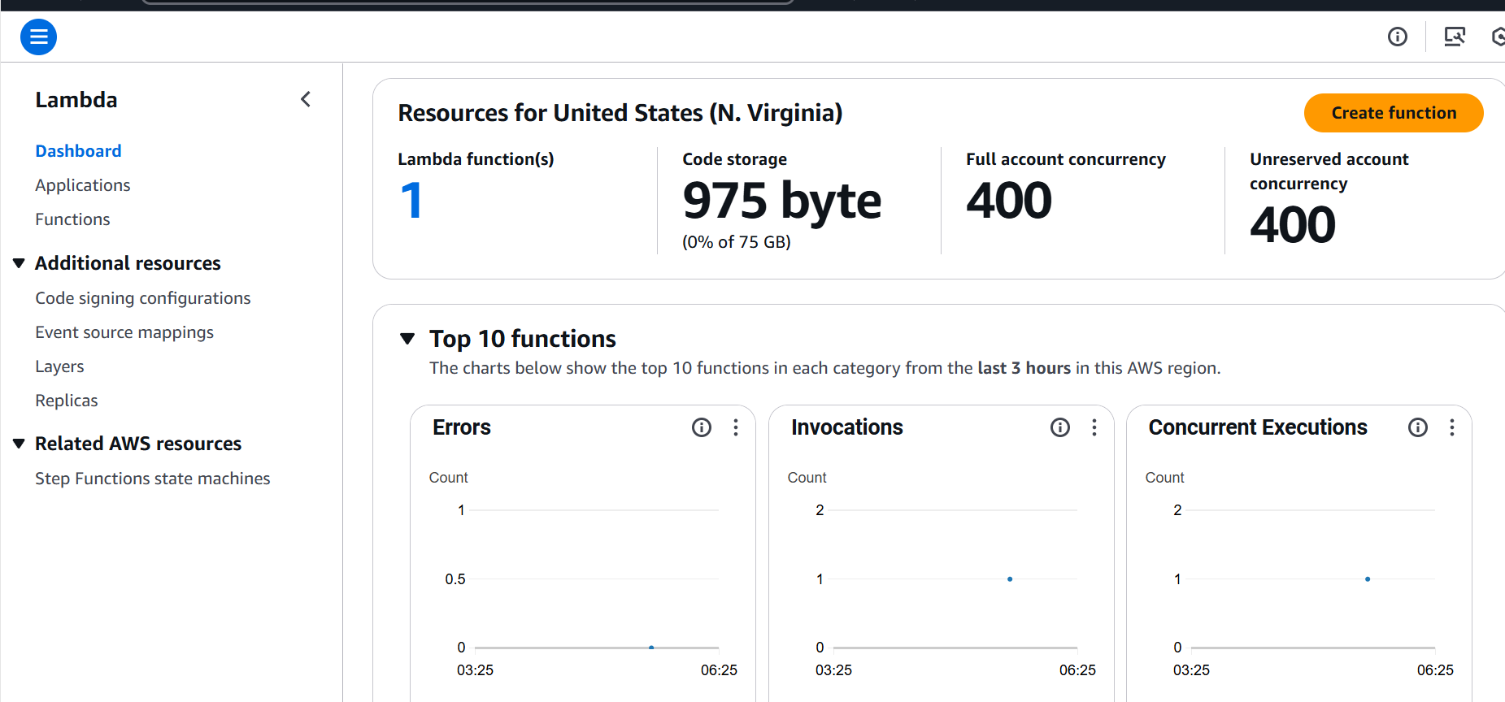
Hands-on

Slide 6
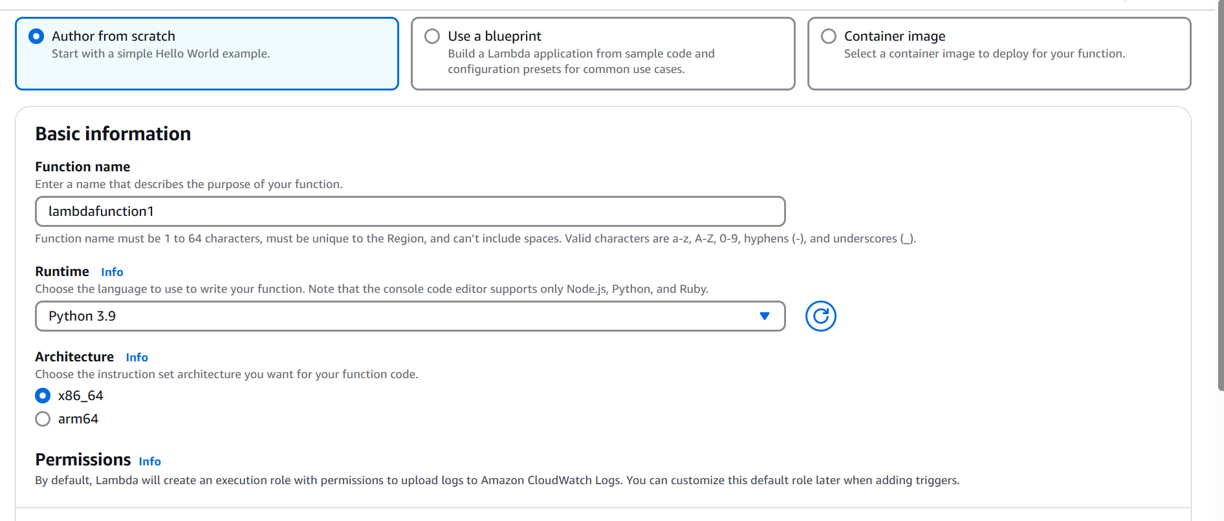
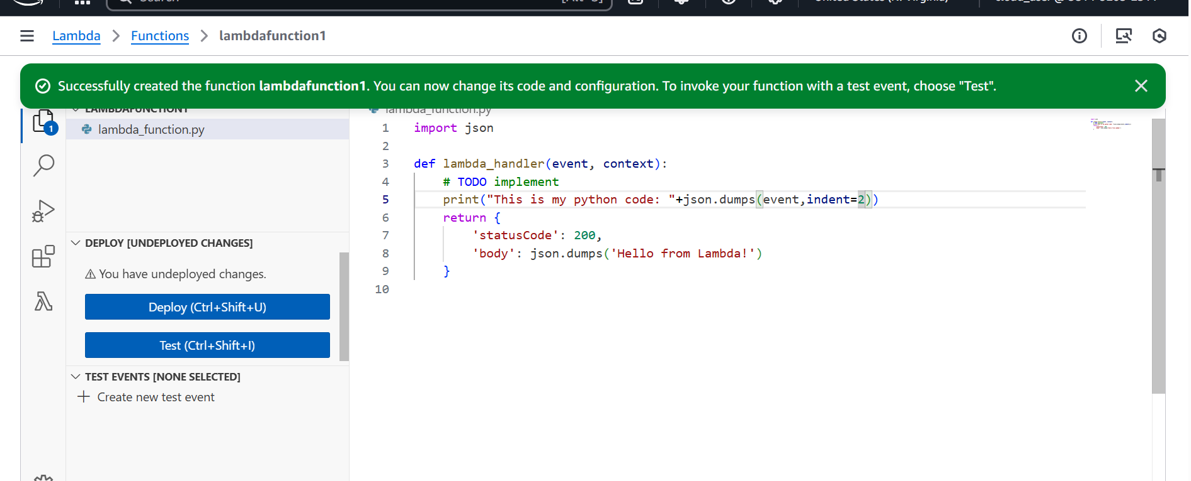

Slide 7
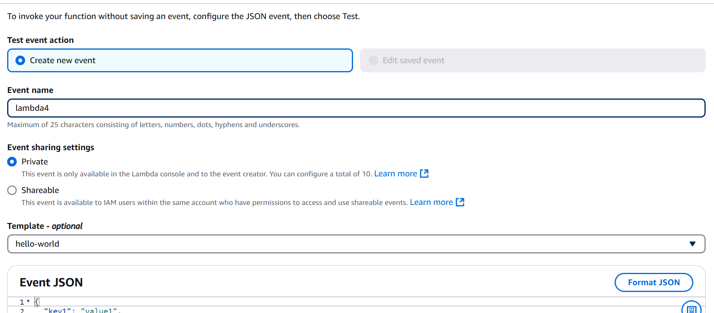
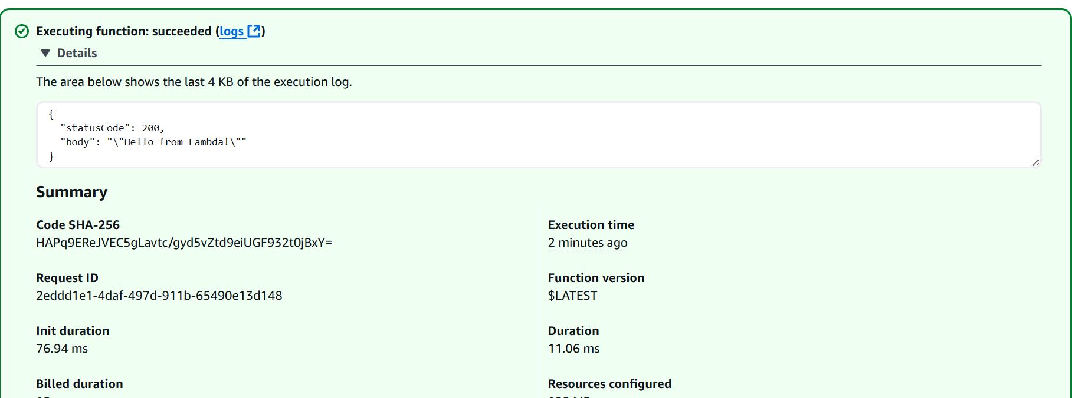

Slide 8
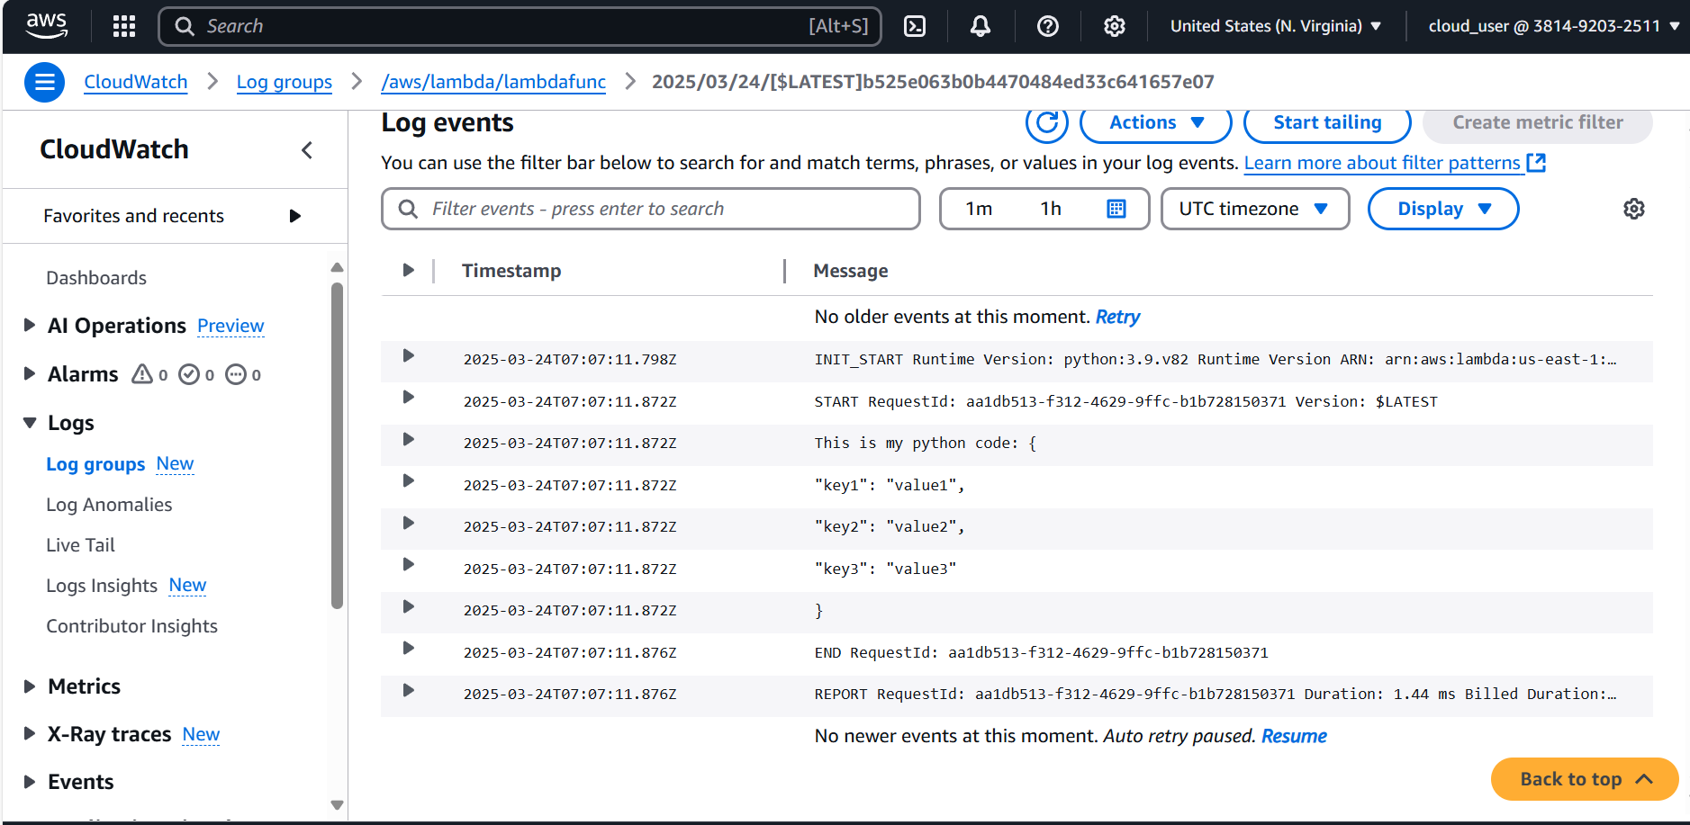

Slide 9
Benefits of AWS Lambda in Serverless Architecture
Event-Driven Execution: Triggered by events like file uploads (S3), table updates (DynamoDB), or API requests.
No Server Management: AWS manages servers; you focus on the code.
Automatic Scaling: Scales from 1 to millions of users automatically.
Pay-per-Use: Pay only for execution time, not idle time.
Supports Multiple Languages: Works with Node.js, Python, Java, Go, and more.

Slide 10
Real-World Use Cases
Automated Image Processing: Automatically resize or compress images uploaded to S3.
Chatbots & Virtual Assistants: Build chatbots or voice-controlled assistants.
Scheduled Data Backups: Schedule data backups for resilience.
Real-Time Analytics: Process streaming data for real-time insights.
API Backends: Create scalable backends for web and mobile apps.

Slide 11
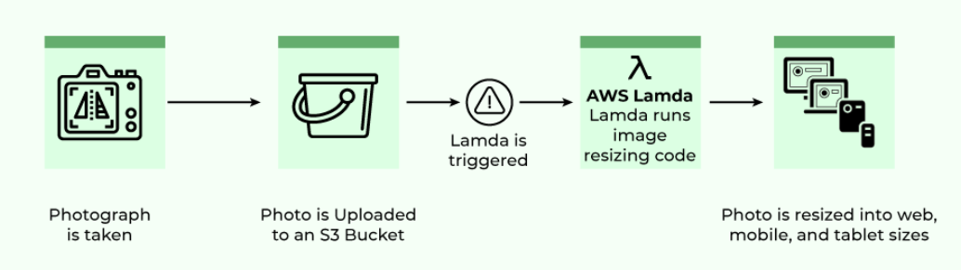
Example: Image Processing with Lambda
Trigger: Image uploaded to S3.
Lambda: Processes image (resize, compress).
Result: Store processed image back in S3 or send it elsewhere.

Slide 12
Lambda Pricing
Requests: 1 million free requests/month.
Duration: Charges based on execution time and memory used.
Free Tier: 400,000 GB-seconds of compute time/month.

